Slide 1
Mental Health Challenges at UWA
Enhancing Support for International Students

Slide 2
Overview
Why is mental health is so important for international students?
Challenges UWA faces and new initiatives to improve students’ mental health
Scholarly Support and Implementation Strategy in UWA
Outcomes and new challenges in implementing the initiative

Slide 3
Detriments to our Mental Health
Cultural adjustment
Academic pressure
Social isolation
Financial issue

Slide 4
Why good mental health is important
Foster motivation, perseverance and positive attitude
Feel energetic and active to chase their dreams
Feel easier to connect with others and build friendships
Keep focus and concentration, better stress management
Combat with loneliness and homesickness
Avoid physical illness

Slide 5
Current Resources in UWA
Free services
Low cost/ Paid services
Student assist
UWA COUNSELLING AND PSYCHOLOGICAL SERVICES
Team of independent social workers and counsellors,
confidential and with a low barrier of entry
UWA students, helping with personal mental health
issues that play a part in
mental health.
ACCESS DEPARTMENT
UWA MEDICAL CENTRE – MENTAL HEALTH NURSE:
A new UWA department, Offering peer support groups and advocacy events.
Available upon referral by a GP at UWA medical centre.
UWA MEDICAL CENTRE
ROBIN WINKLER CENTRE
Can discuss management of mental health conditions.
Low Cost Therapy on campus, No GP referral needed.
(UWA Student Guild,2024）

Slide 6
Challenges
UWA provided mental health resources, but students felt that more positive and ongoing support could be in place (University of Western Australia, 2022).
International students feel isolated and unaware of available mental health services (ICEF, 2022).
Missing early signs of depression and anxiety
Seek help when physical symptoms appear

Slide 7
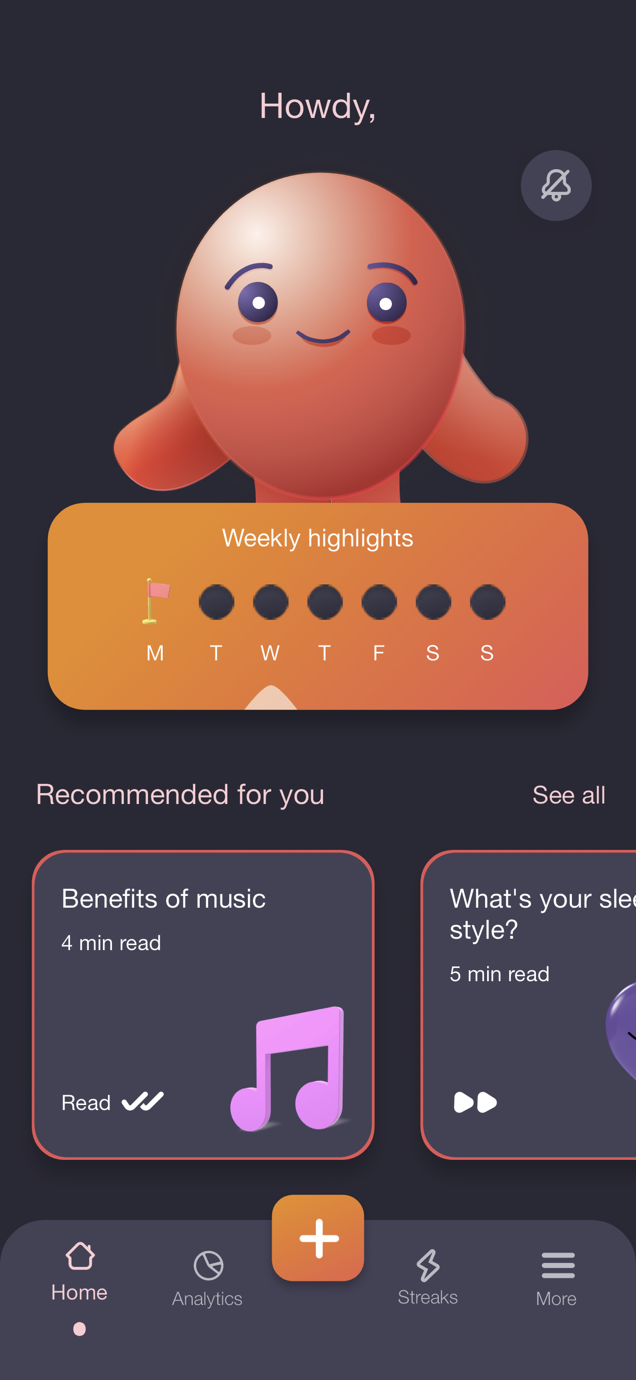
Proposed Initiative
Concept
MindTrack — Smartphone application
Aim: Help students understand and manage their emotion
Daily mood tracker
Alert students to potential mental health problems
Integrate educational content and consulting services

Slide 8








Current progress
Counselling
Mental health problem
Studying
Unsuccessful
App
Self report and analysis
Counselling with app data
Warning
Guidance
Motivation
Our Intervention

Slide 9
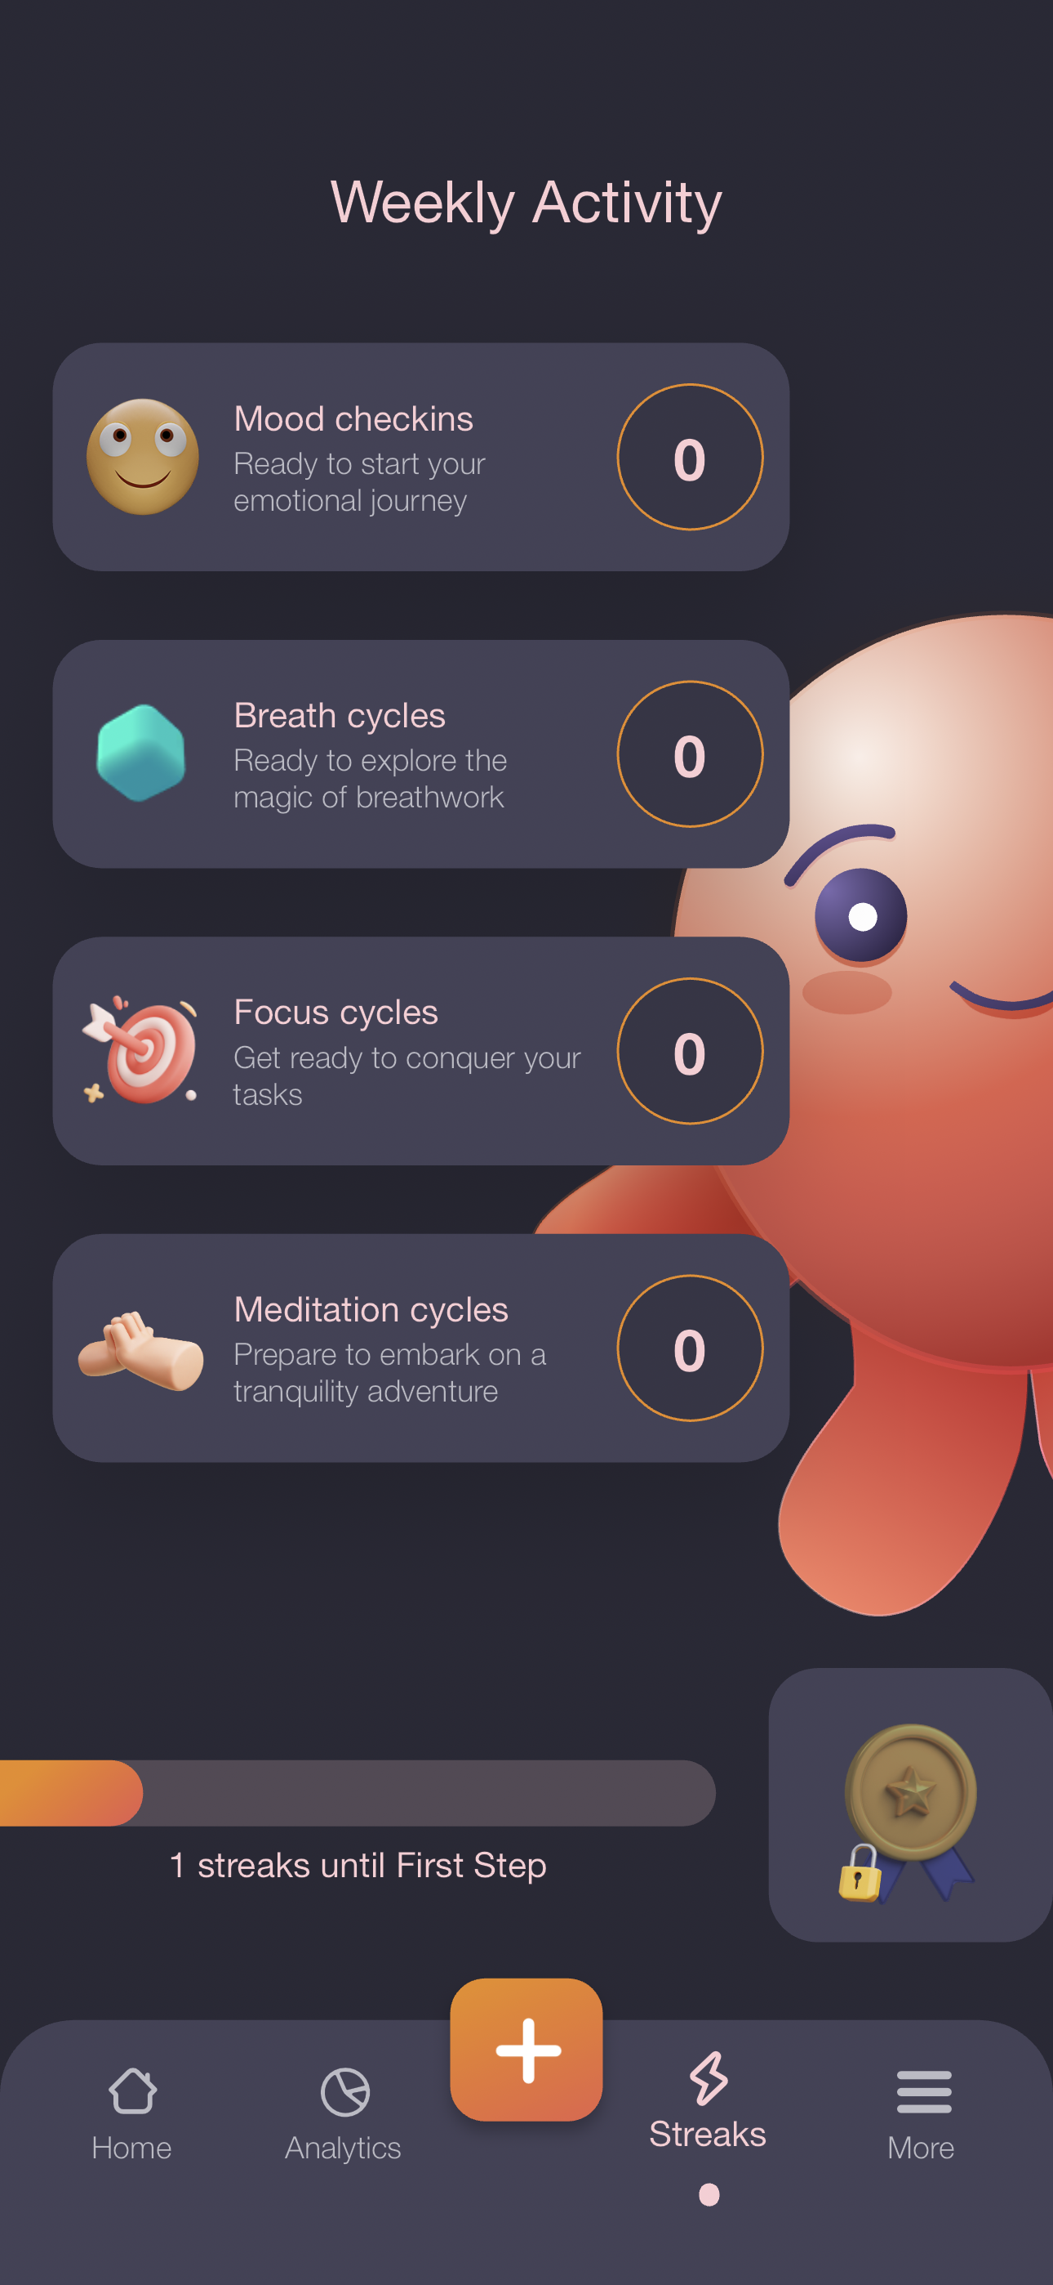
Except Main Functions
Receive timely guidance
Can be based on how much workload, system specific to make guidance
Activities & Notification
Practice mindfulness and relaxation daily based on state of mind reminders
Provide information about upcoming workshops and support groups
A weekly and monthly summary of user sentiment trends

Slide 10
More Important
1
2
3
4
University can adjust the assignment allocation
Effectively arrange the assignment due date
Reduce the burden of overly focused deadlines
Improves overall academic performance

Slide 11

Justification for the MindTrack App
Self-Managed Mental Health
Psychological Health Support
Personalized Real-Time Feedback
The potential of collaborative innovation

Slide 12

Resourcing the Proposed Program
University Resources
External Funding Sources
Technical and Professional Team
Health services and Psychology Departments

Slide 13
Expected Outcomes Short-term benefits
M
relax
Daily Life
Emotion
Immediate reduction in academic stress and anxiety.
Increased awareness of students' daily mental health and self-care.
Enhance students' emotional awareness and coping skills.

Slide 14
Expected Outcomes Long-term benefits
Development of healthy psychological coping mechanisms
Reduction of long-term mental health problems
Improved academic performance and student’s quality of life.
Establishment of mental health support systems and resources.

Slide 15
Potential Barriers
Cultural and social biases prevent students from seeking help.
Financial and human resource constraints.
Lack of adequate mental health resources and professionals.

Slide 16
Mitigation Strategies
1
2
3
Apply for an increase in the school's budget or seek financial support from the government and private sector.
Raise mental health awareness through educational seminars and campaigns.
Increase mental health professionals and resources on campus.

Slide 17
Conclusion
Existing Mental Health Problems and the Benefits of Maintaining Mental Health
01
04
Potential Challenges
UWA to effectively respond to mental health challenges faced by international students
Recommended to introduce MindTrack application
02
05
Short-term benefits and Long-term benefits
03
06
Creating a more supportive and inclusive learning environment

Slide 18
Reference
Priyadarsini, I., Chakrapani, I. S., Manochitra, S., Tejaswini, B., Ramesh, S., & Alaskar, K. (2023). IoT based mobile app for continuous health monitoring of the person. AIP Conference Proceedings, 2690(1). https://doi.org/10.1063/5.0120557
Iwaya, L. H., Babar, M. A., Rashid, A., & Wijayarathna, C. (2023). On the privacy of mental health apps: An empirical investigation and its implications for app development. Empirical Software Engineering, 28(1), 2. https://doi.org/10.1007/s10664-022-10236-0
Parker, L., Halter, V., Karliychuk, T., & Grundy, Q. (2019). How private is your mental health app data? An empirical study of mental health app privacy policies and practices. International Journal of Law and Psychiatry, 64, 198–204. https://doi.org/10.1016/j.ijlp.2019.04.002
University of Western Australia. (2024). Mental health and wellbeing framework. The University of Western Australia. https://www.uwa.edu.au/-/media/project/uwa/uwa/uwa-corporate/docs/mental-health-and-wellbeing-framework/uwa-mental-health-framework-20240409.pdf
University of Western Australia. (2022). Mental health and wellbeing survey: Infographic summary. The University of Western Australia. https://www.uwa.edu.au/students/-/media/Project/UWA/UWA/UWA-Corporate/Docs/Mental-Health-and-Wellbeing-Framework/20220502_MHaWF-Survey-Infographic-PDF.pdf
ICEF. (2022). Integrating mental health supports throughout the international student journey. ICEF Monitor. https://monitor.icef.com/2022/02/integrating-mental-health-supports-throughout-the-international-student-journey/

